Slide 1
Решение задачи маршрутизации транспорта с ограничениями

Slide 2
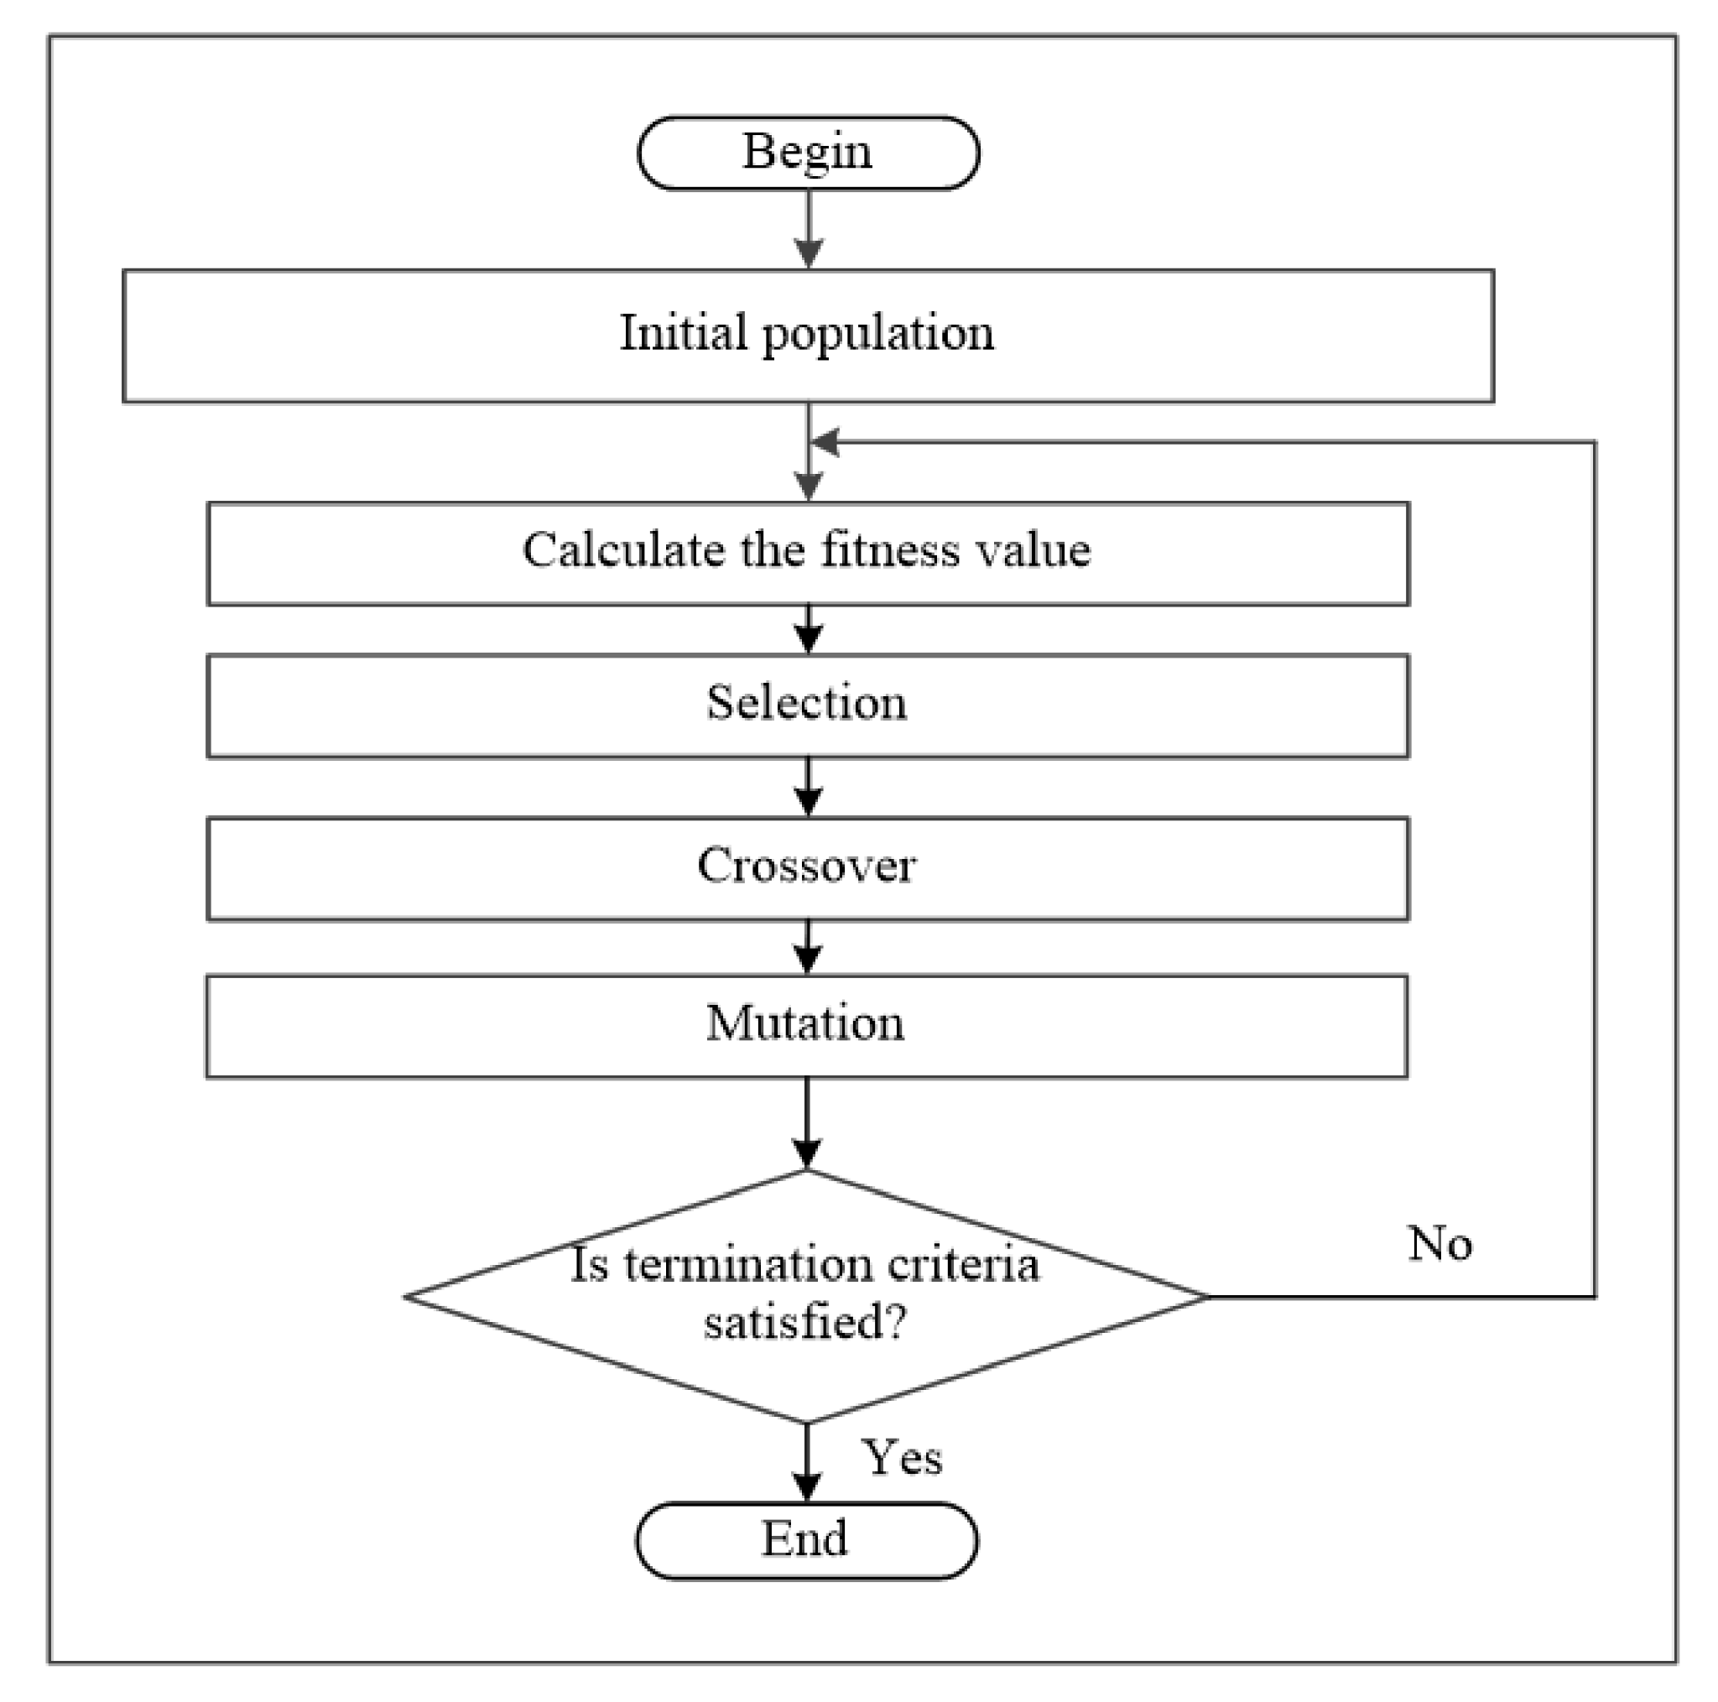
Обзор генетического алгоритма (GA)

Slide 3
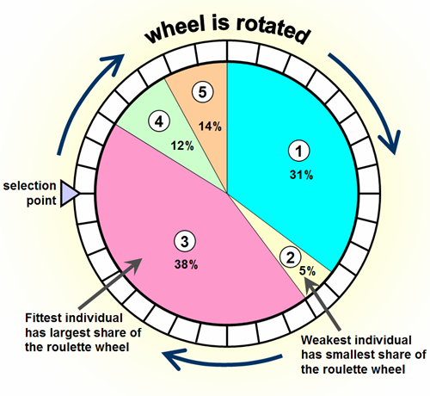
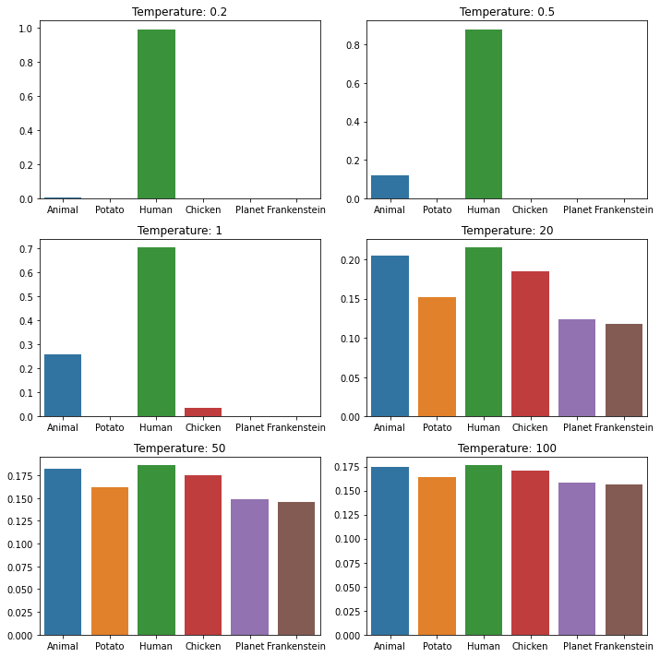
Селекция
Выбор колеса рулетки (Roulette Wheel Selection) c температурой

Slide 4
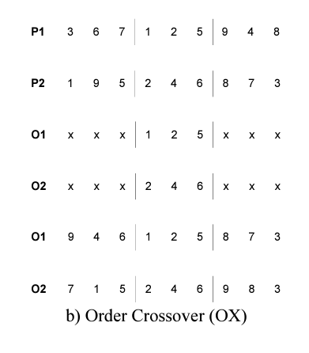
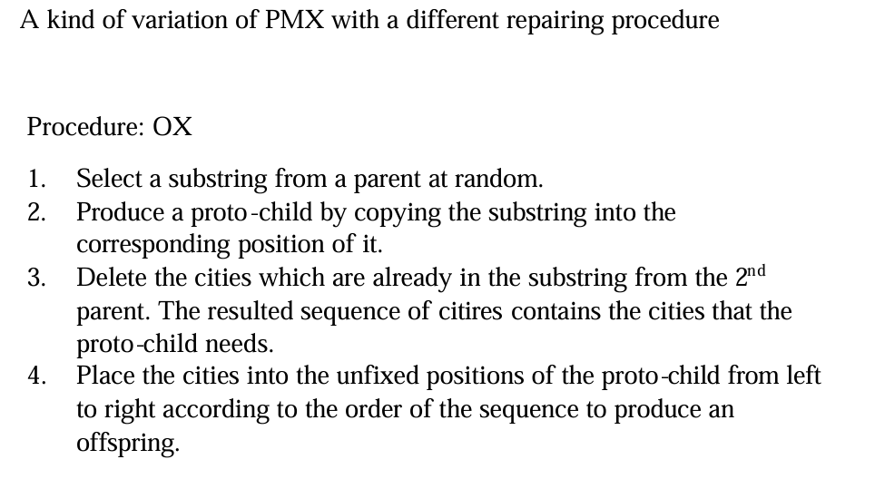
Кроссовер
https://mat.uab.cat/~Alseda/MasterOpt/GeneticOperations.pdf
http://ieomsociety.org/proceedings/2021indonesia/274.pdf

Slide 5
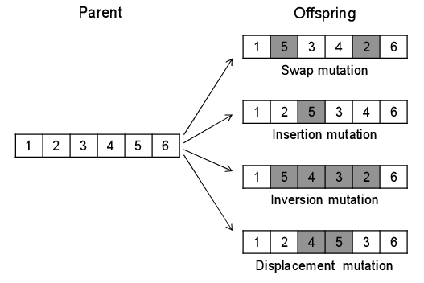
Мутация
Swap mutation
Insertion mutation
Inversion mutation
Split mutation
Concat mutation

Slide 6
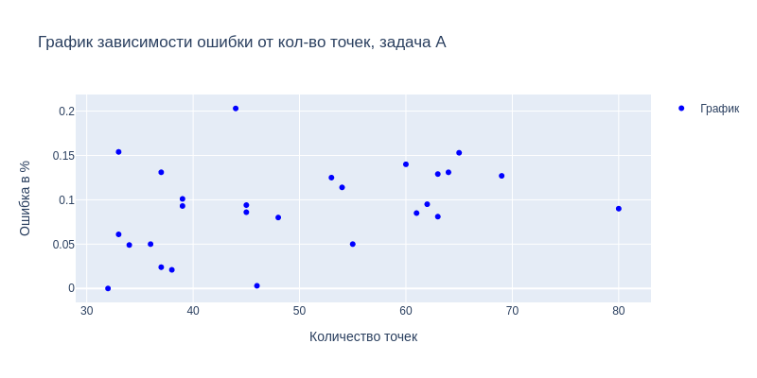
Результаты

Slide 7
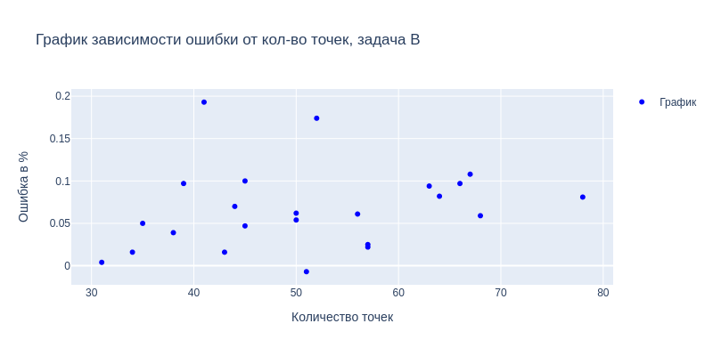
Результаты

Slide 8
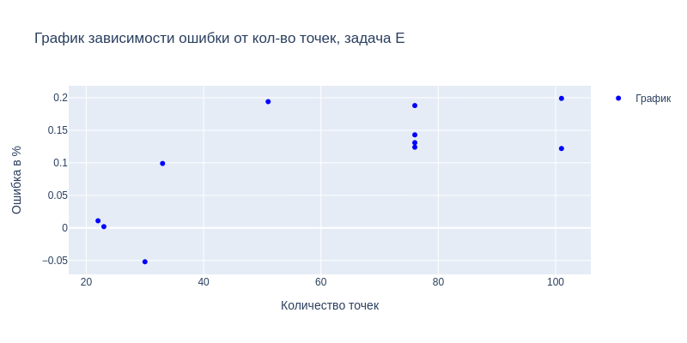
Результаты

Slide 9
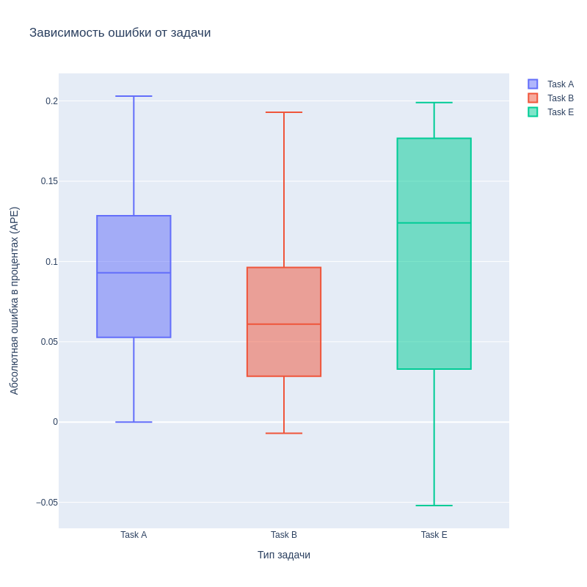
Результаты
“One thing should be noticed, namely that in the case of B-n51-k7, the proposed algorithm finds a shorter distance than the best known one by using one more vehicle.”
Computing and Informatics, Vol. 30, 2011, 721–732

Slide 10
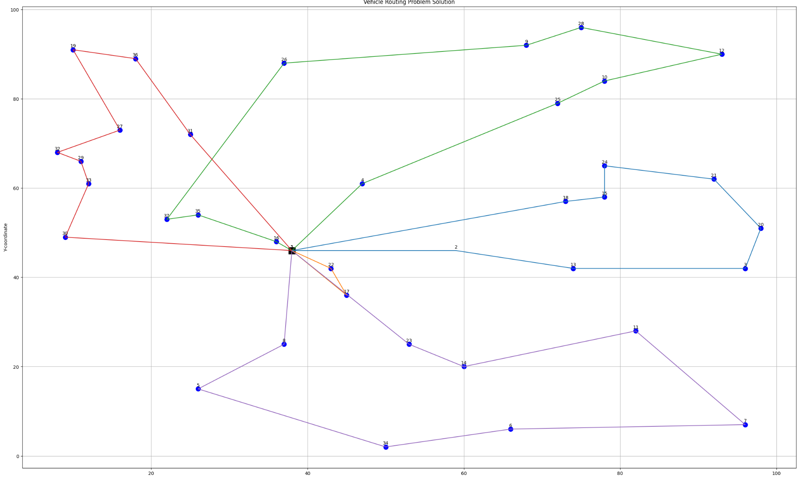
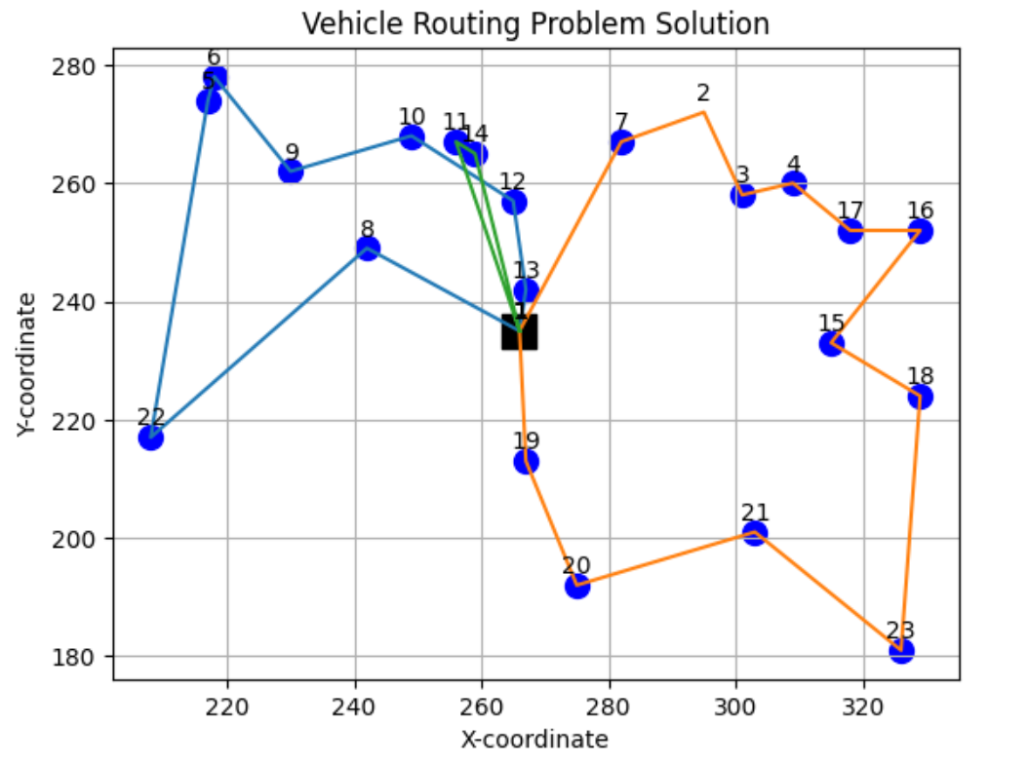
Пример
Notes:
One thing should be noticed, namely that in the case of B-n51-k7, the proposed algorithm finds a shorter distance than the best known one by using one more vehicle.

